Slide 1
Free Time
By Łukasz Kordoń & Bartek Kieś

Slide 2
I really like volleyball, so during my free time I often play it outside with my little brother Mateusz

Slide 3
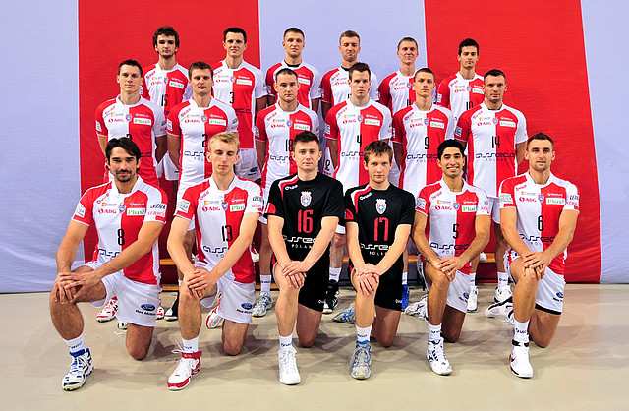
My favourite volleyball team is Asseco Resovia, so every time they play a match I must be there supporting them!

Slide 4
Krzysztof Gierczyński is my favourite player from Asseco Ressovia. He is my idol. One day i hope to play volleyball just as good as him.

Slide 5
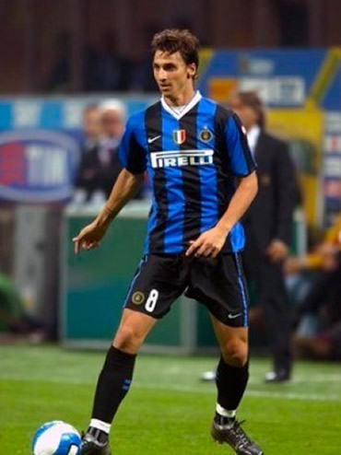
Zlatan Ibrahimović is my favourite football player. When im bored at home i often go outside and practise football thinking of Zlatan, it makes me play football better.

Slide 6
I have three beautiful and amazing dogs, I call them Arrakis, Kobza and Kropka. I take them for a walk very often because they are very energetic and need a lot of running.

Slide 7
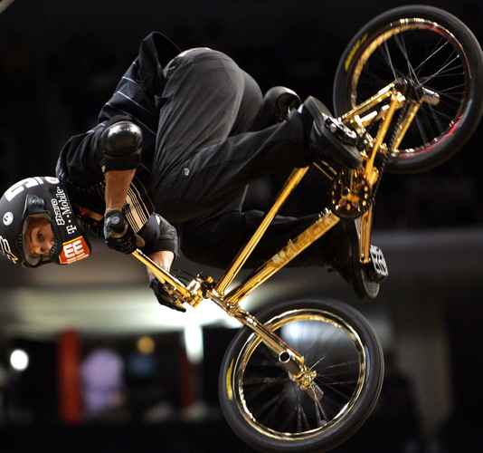
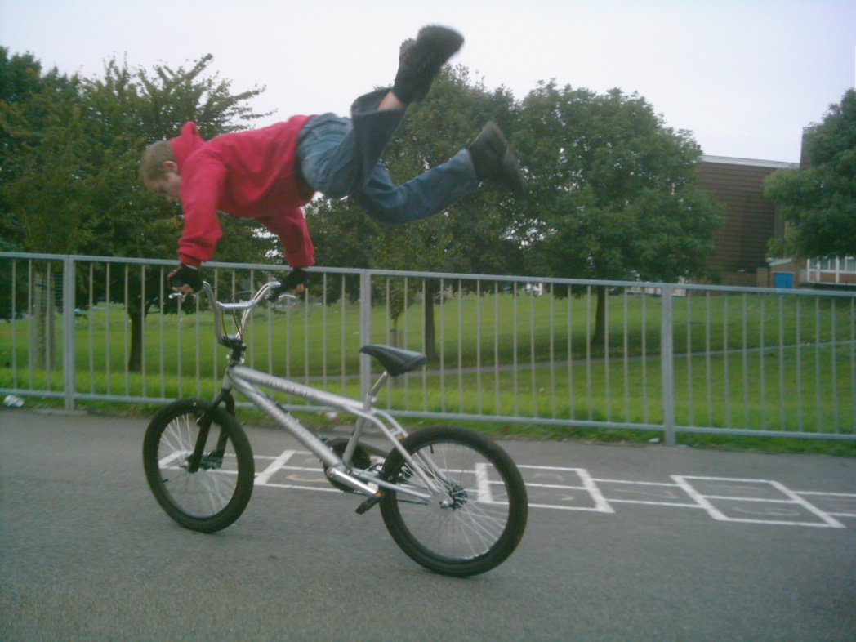
During my free time in summer I really like riding my bicycle and doing tricks on it. Some day I hope to be as good as Dave Mirra (photo above) and do everything I can imagine with my BMX bike.

Slide 8
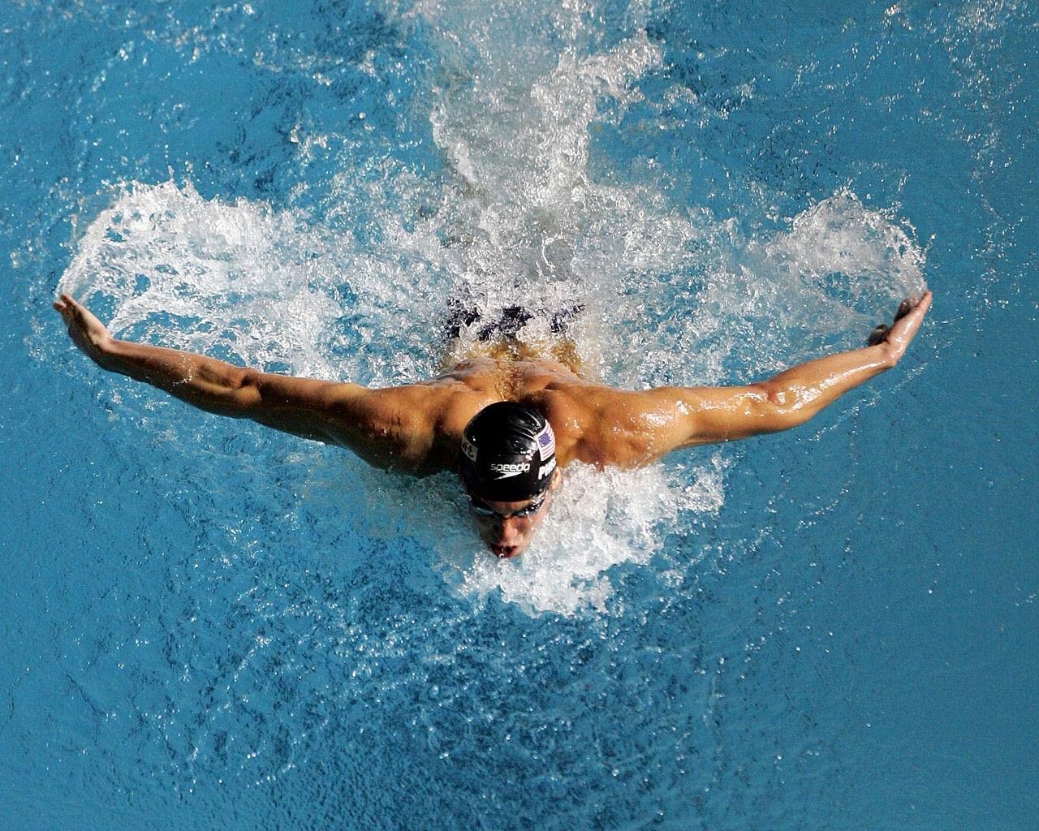
Sometimes during summer I go out with my friends to a swimming pool. I’m not very good at swimming but I keep learning.

Slide 9
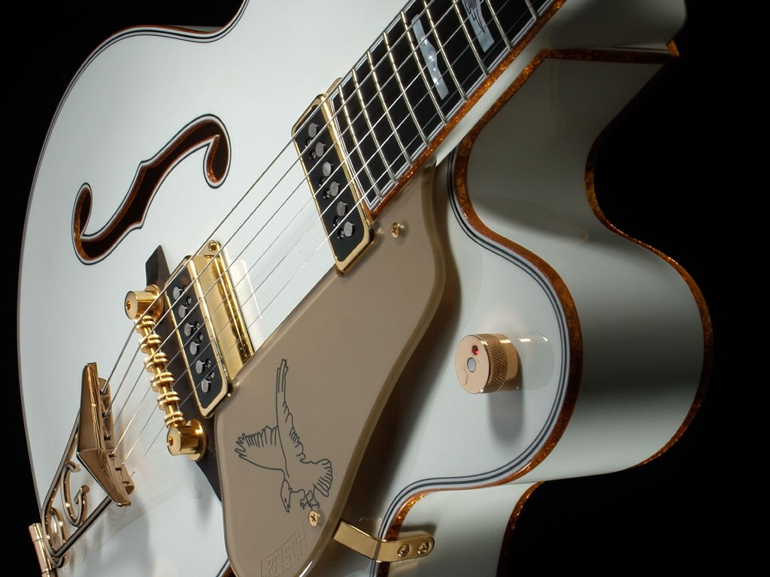
When outsiede it’s raining and I can’t go ride my bicycle I play the guitar, it makes me feel alright, also I’m just a beginner.

